Slide 1

Games !!
A few demo programs using pygame and pygwidgets.
Each program will present one or more reusable classes and show how they can be used in sample projects.

Slide 2
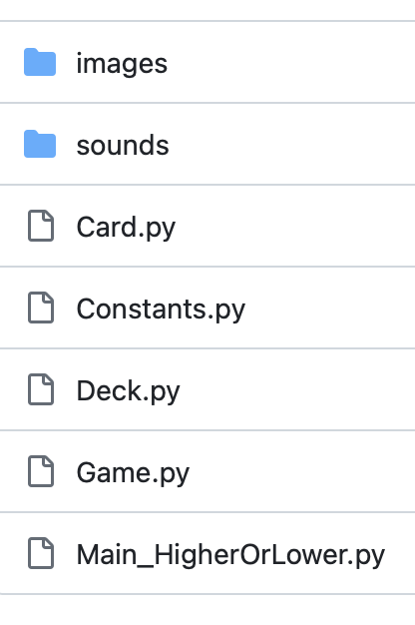
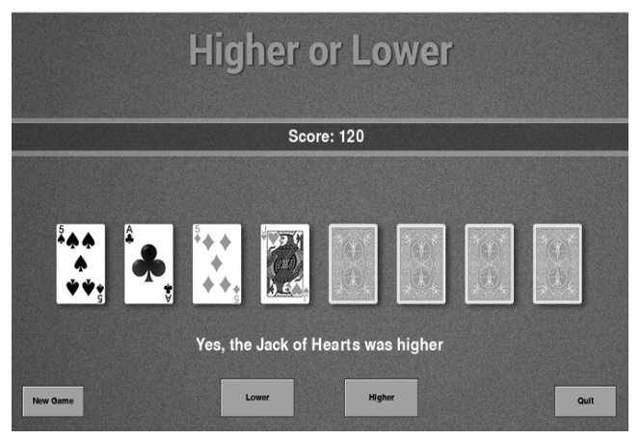
Card Game
Game rules:
we start with seven cards face down and one card face up.
The player guesses whether the next card to be turned over will be higher or lower than the last visible card by pressing Lower or Higher.
When the game is over, the user can click New Game to start a new round of the game.
The player starts with 100 points, gains 15 points for a correct answer, and loses 10 points for an incorrect answer.

Slide 3
Card Class: To represent a card
Data
Methods
Rank (ace, 2, 3, ... 10, jack, queen, king)
Suit (clubs, hearts, diamonds, spades)
Value (1, 2, 3, ... 12, 13)
Name (built using the rank and suit: for example, 7 of clubs)
Image of the back of the card (a single image shared by all Card objects)
Image of the front of the card (a unique image for each Card object)
__init__()
conceal()
reveal()
getName()
getValue()
getSuit()
getRank()
setLoc()
getLoc()
draw()

Slide 4
Deck Class: An object manager to create and manage 52 Card objects
Data
Methods
startingDeckList
playingDeckList
__init__()
shuffle() randomizes the deck
getCard() retrieves a card from the deck
returnCardToDeck() put a card back into the deck

Slide 5
Game Class: To handle the actual game logic
Data
Methods
window
oDeck
score
scoreText
messageText
loserSound
winnerSound
cardShuffleSound
cardXPositionsList
__init__()
reset()
getCardNameAndValue()
showCard()
hitHigherOrLower()
draw()

Slide 6
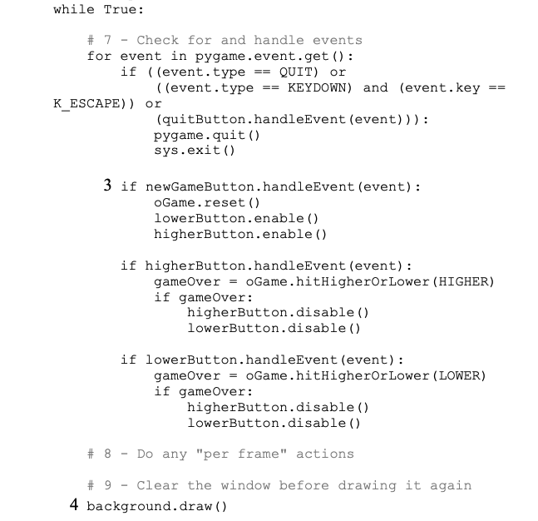
Main Program
Sets up the world and contains the main loop.
Also creates the Game object that runs the game.

Slide 7
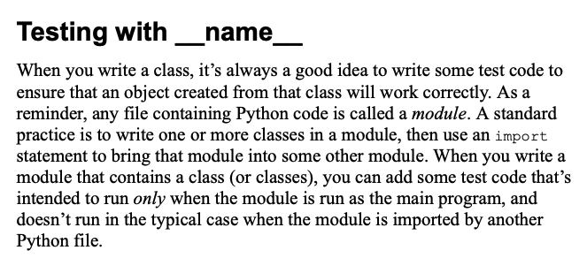
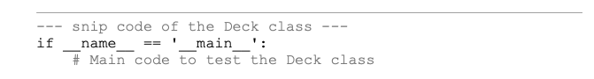

Slide 8
References
https://github.com/IrvKalb/Object-Oriented-Python-Code/tree/master/Chapter_12/HigherOrLower

Slide 9

Sprites and Platforms
A sprite is a two-dimensional image that is part of the larger graphical scene.
Good platforms can move side to side -- scrolling platform.
Even cooler platform games have platforms that move!

Slide 10
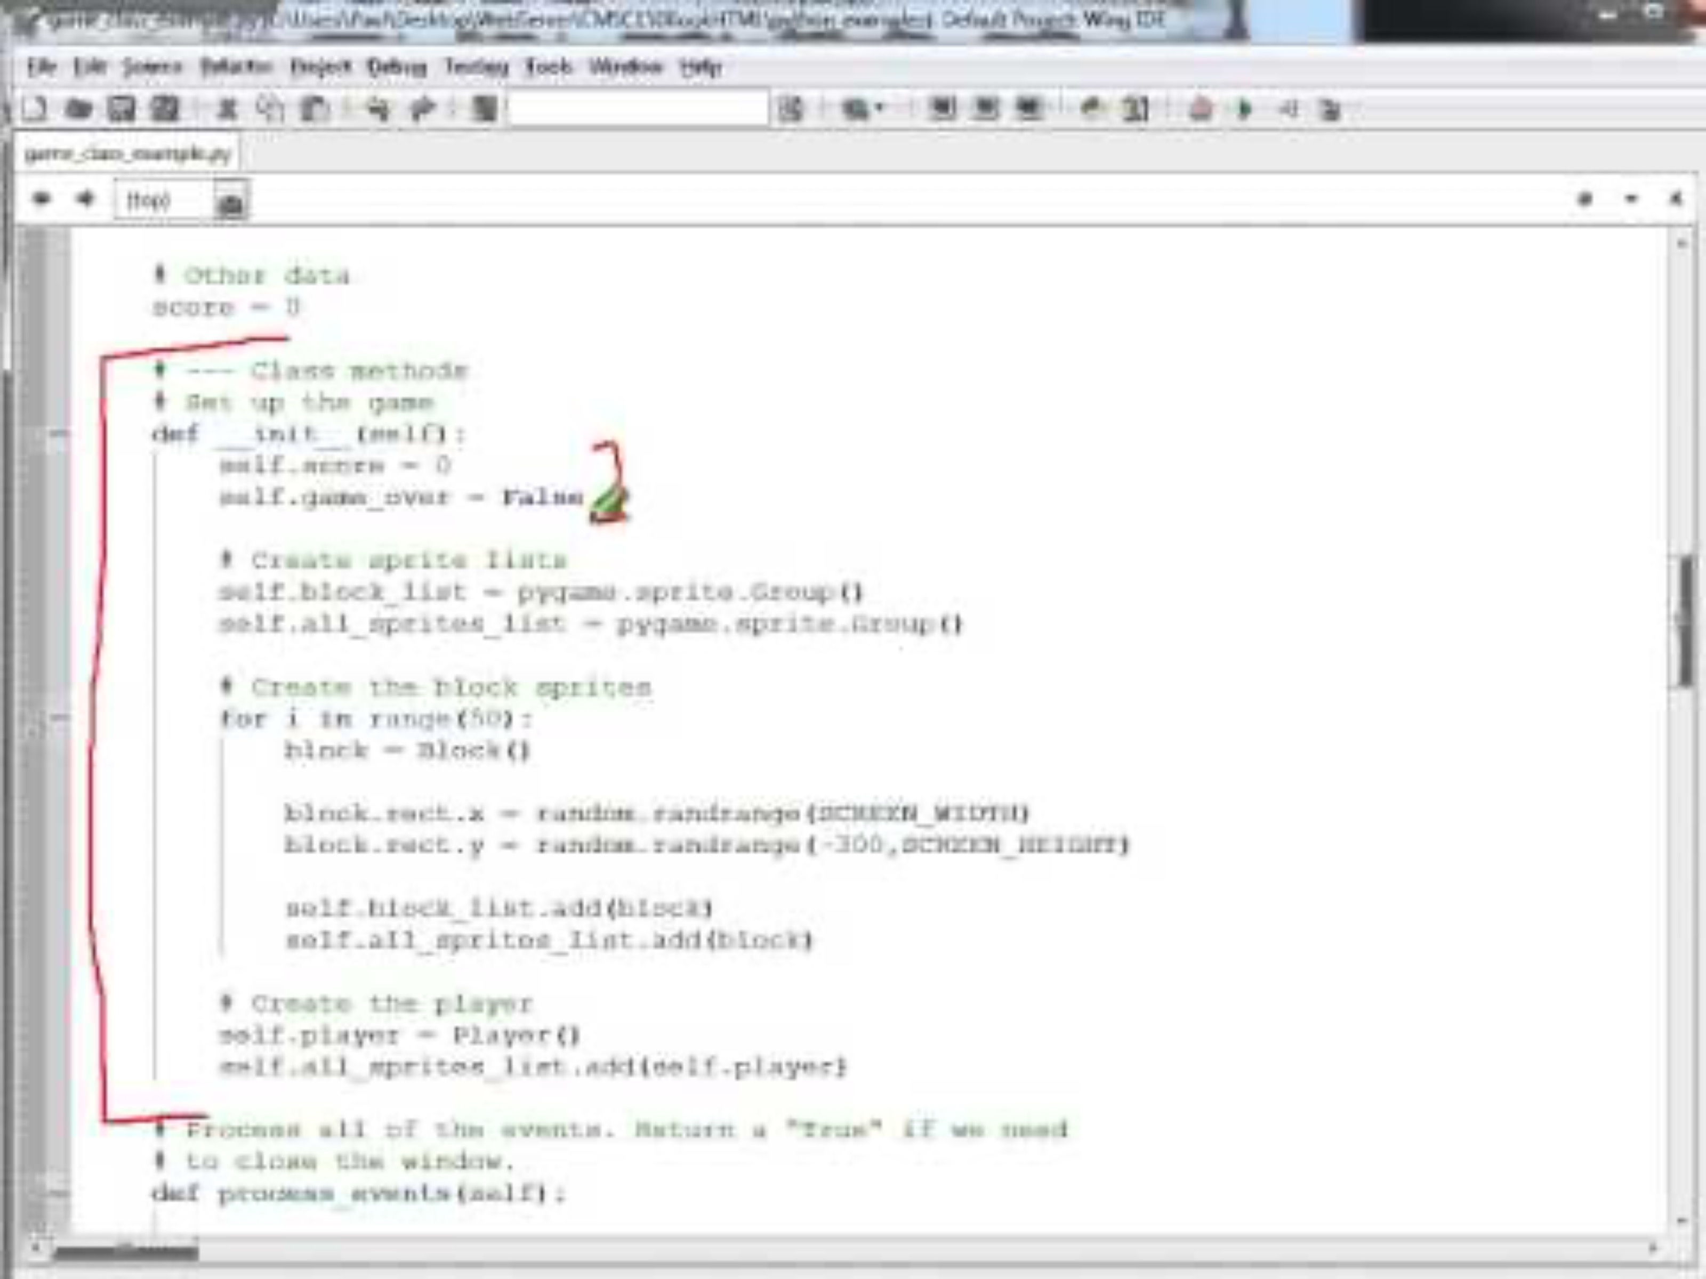
Collecting Blocks Game
Block
Game
Main
Player
http://programarcadegames.com/python_examples/show_file.php?file=game_class_example.py (0:29)

Slide 11
Collecting Blocks Game
Block
Game
Main
Player
http://programarcadegames.com/python_examples/show_file.php?file=game_class_example.py (0:29)

Slide 12
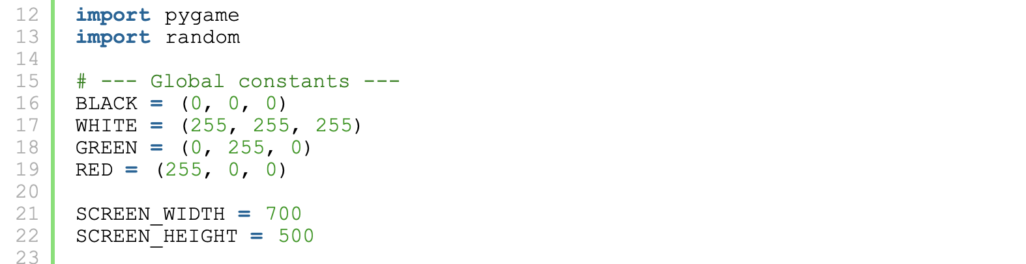
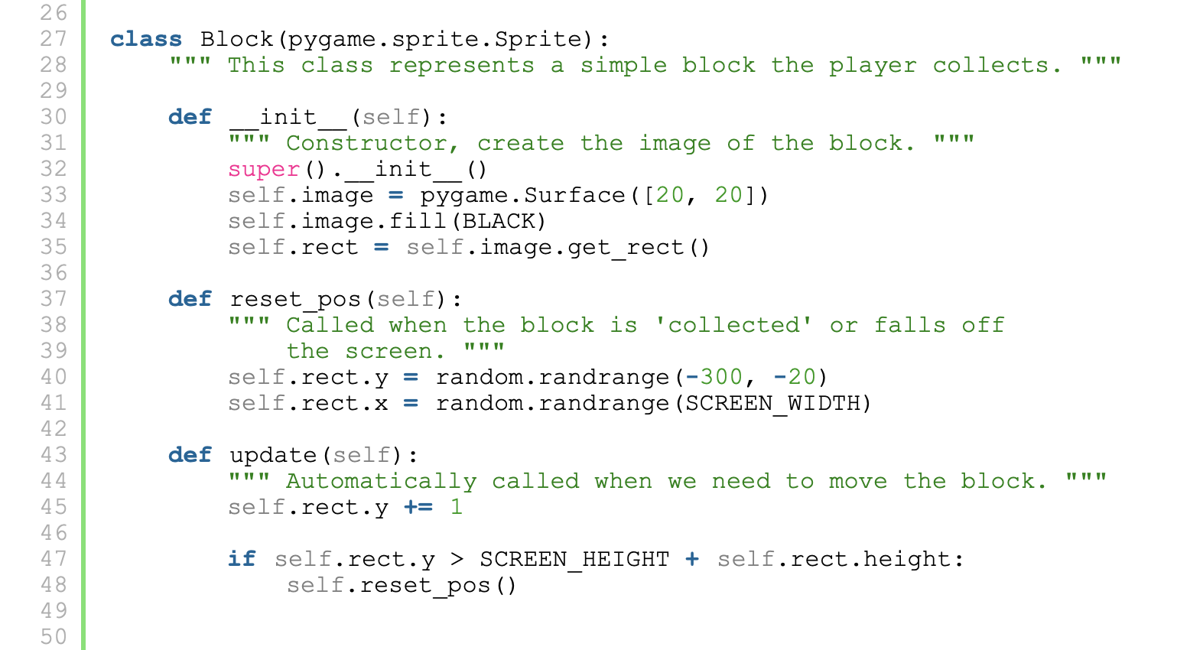
Collecting Blocks Game

Slide 13
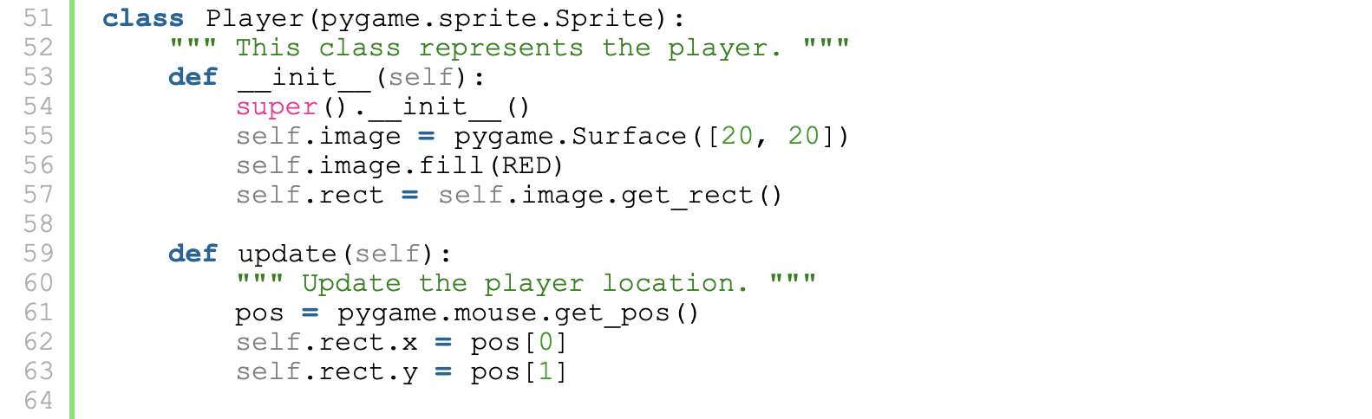
Collecting Blocks Game

Slide 14
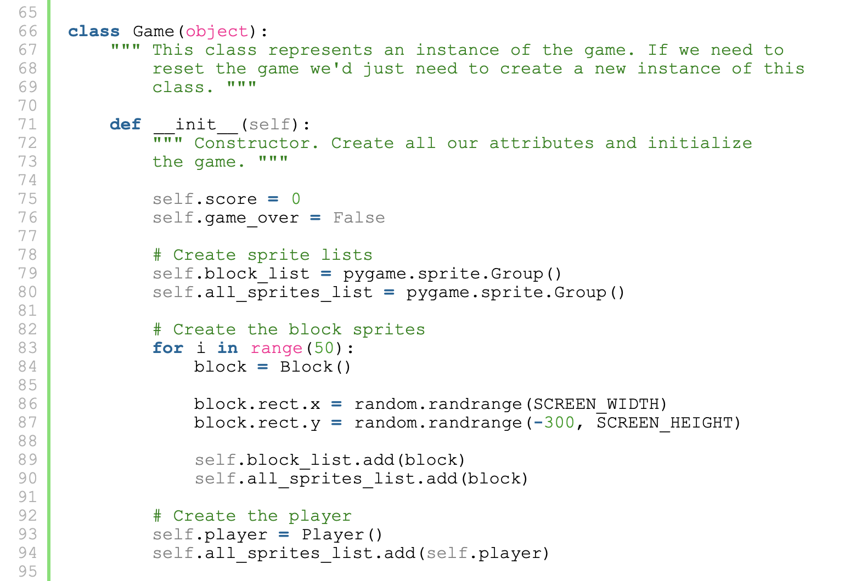
Collecting Blocks Game

Slide 15
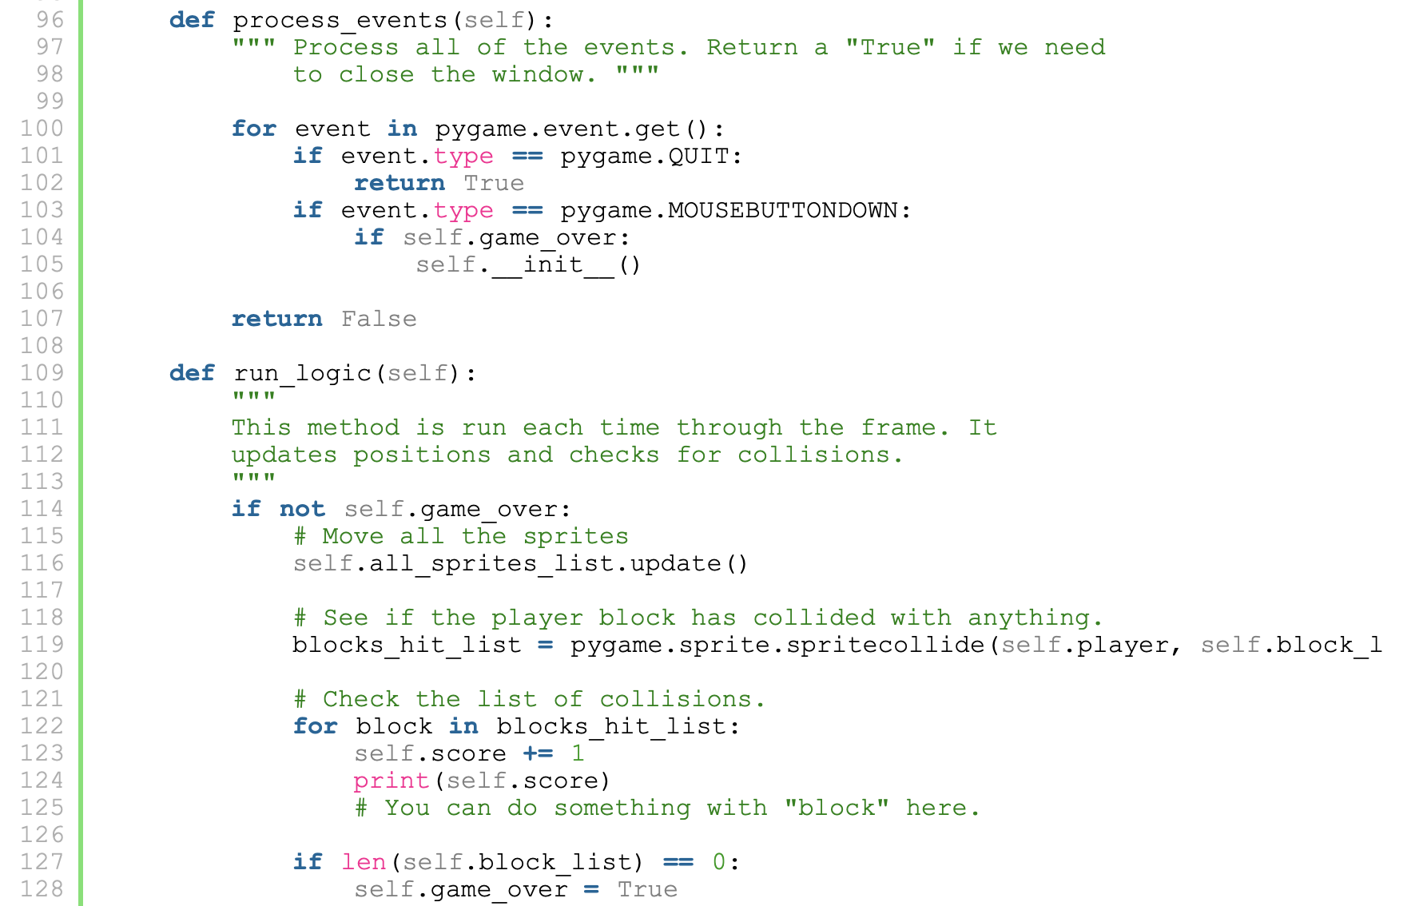
Collecting Blocks Game

Slide 16
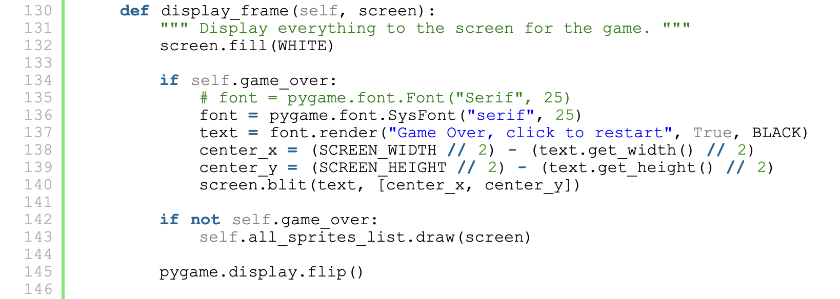
Collecting Blocks Game

Slide 17
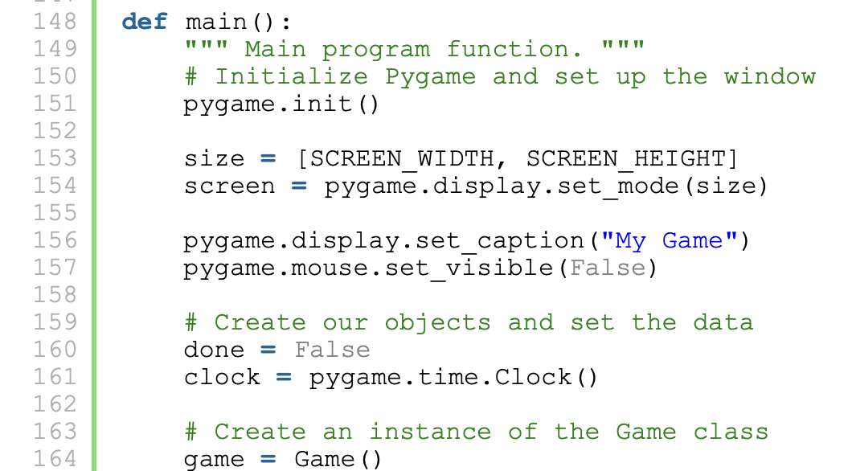
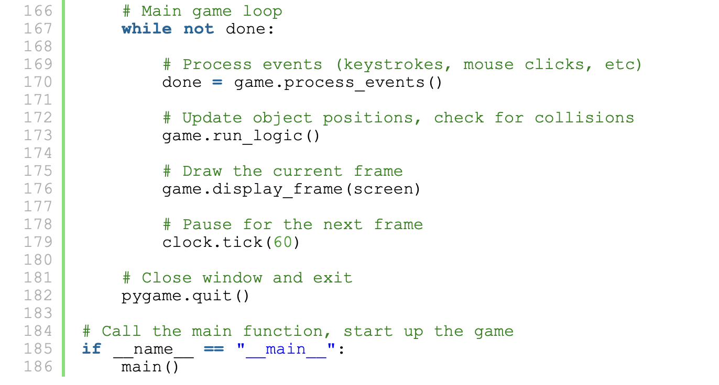
Collecting Blocks Game

Slide 18
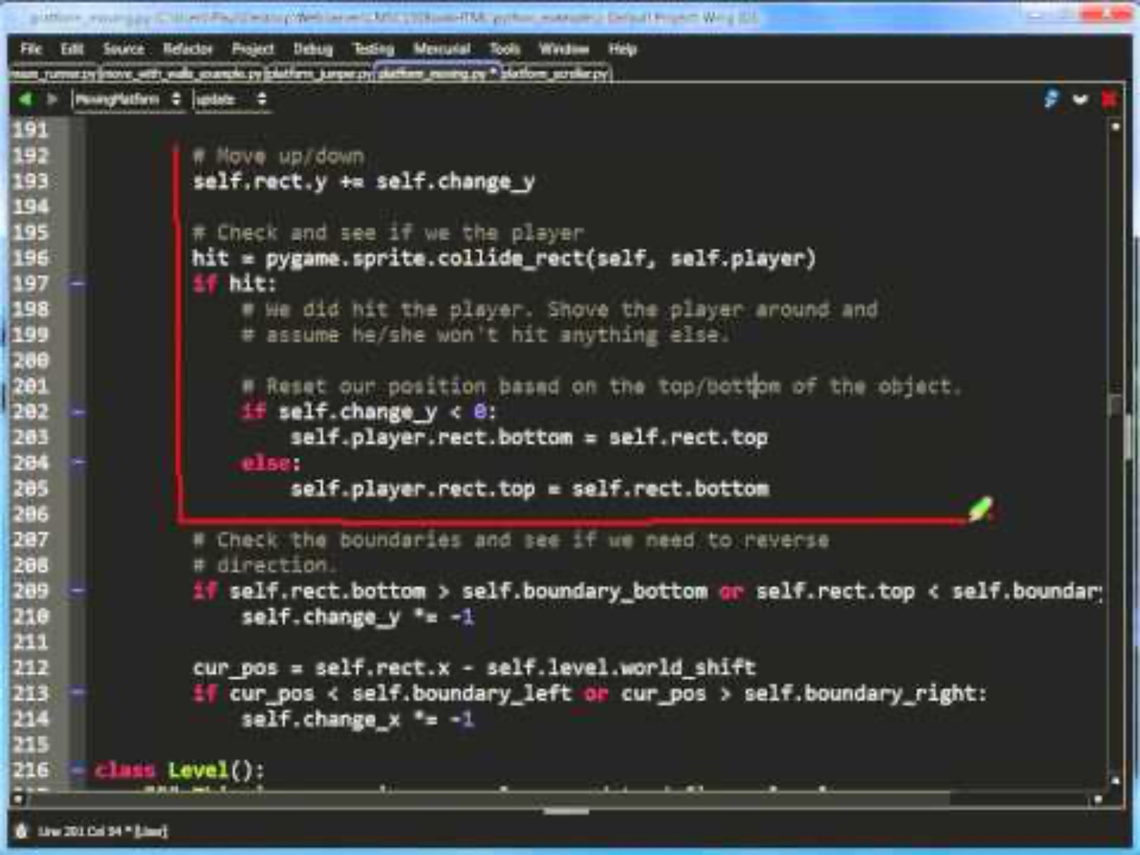
Mario-Like Game
Main
http://programarcadegames.com/python_examples/show_file.php?file=platform_moving.py (0:00)

Slide 19
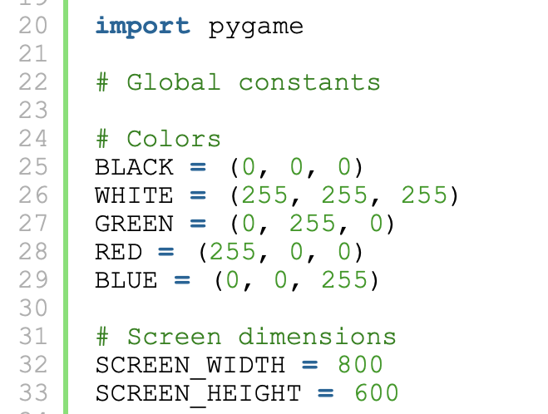
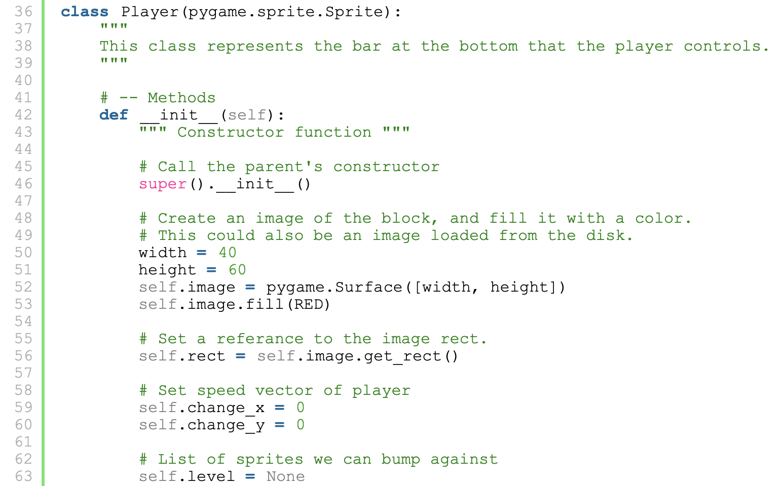
Mario-Like Game

Slide 20
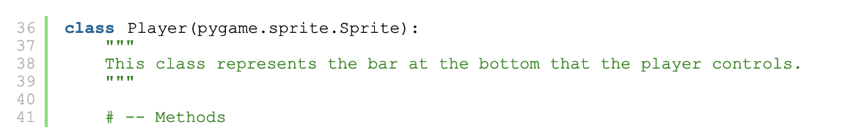
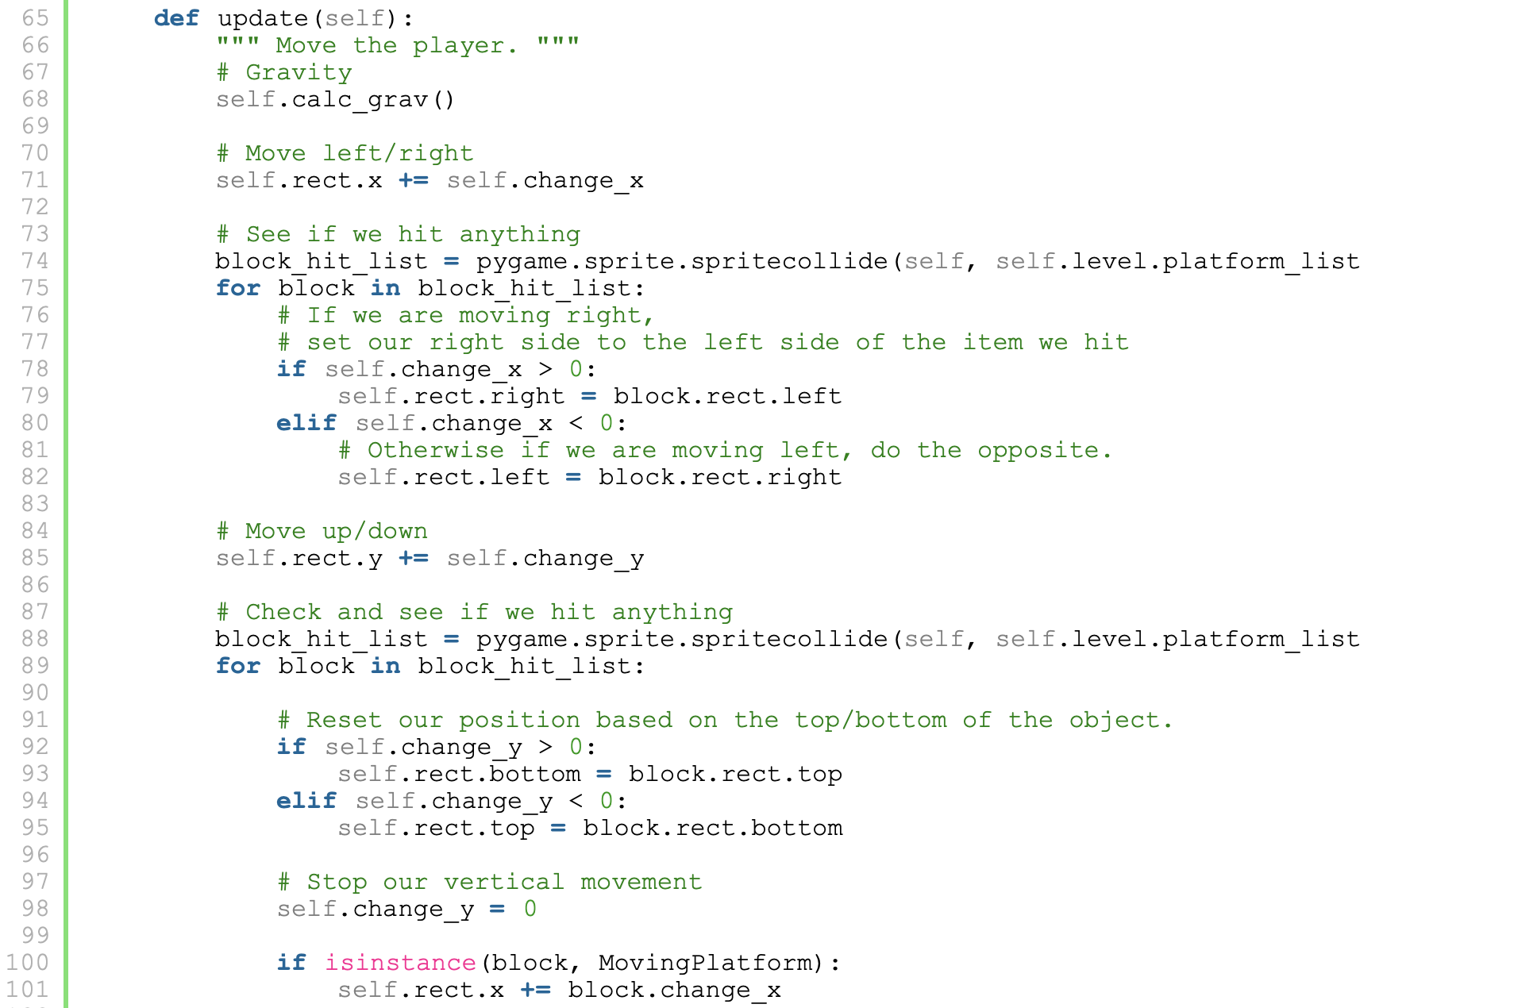
Mario-Like Game

Slide 21
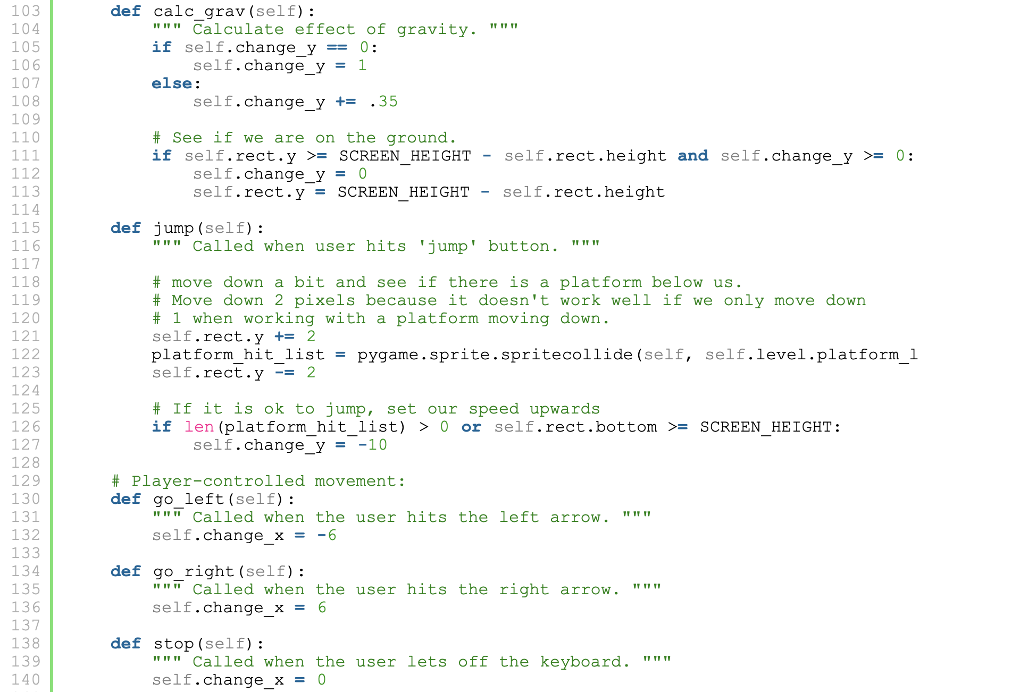
Mario-Like Game
Player
update
calc_grav
jump
go_left
go_right
stop

Slide 22
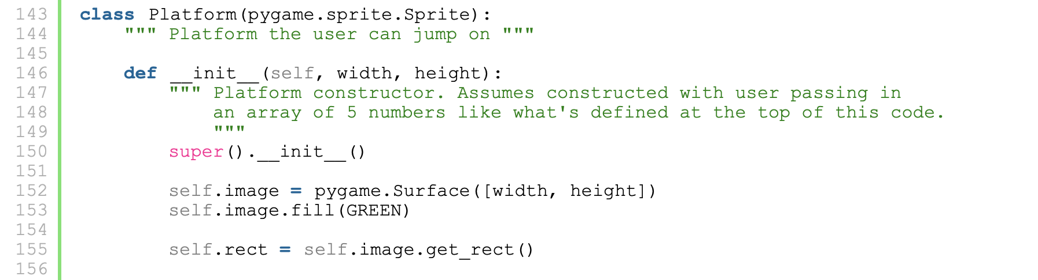
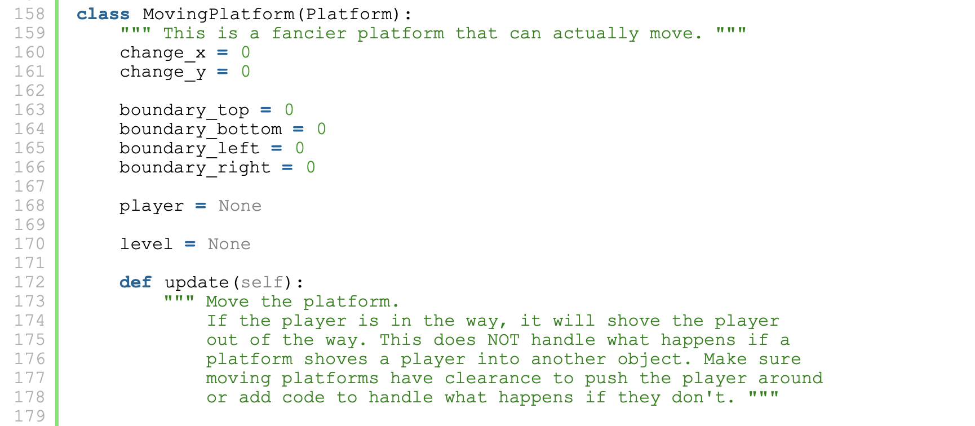
Mario-Like Game

Slide 23
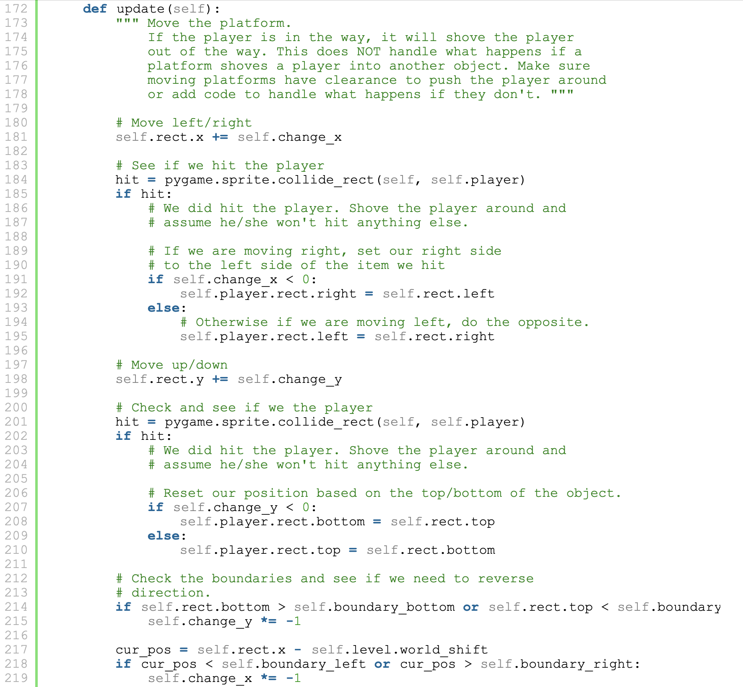
Mario-Like Game
MovingPlatform
update

Slide 24
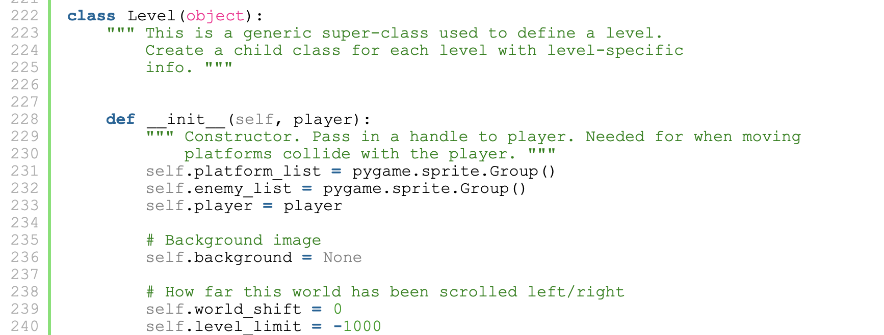
Mario-Like Game

Slide 25
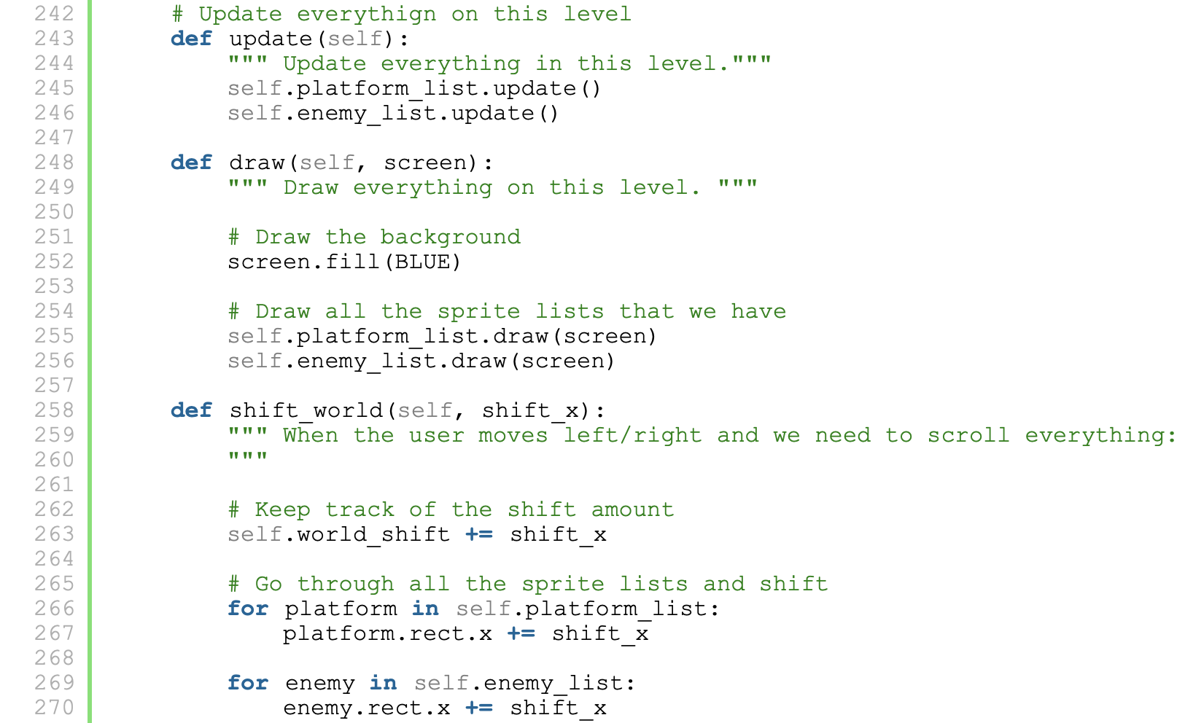
Mario-Like Game
Level
__init__
update
draw
shift_world

Slide 26
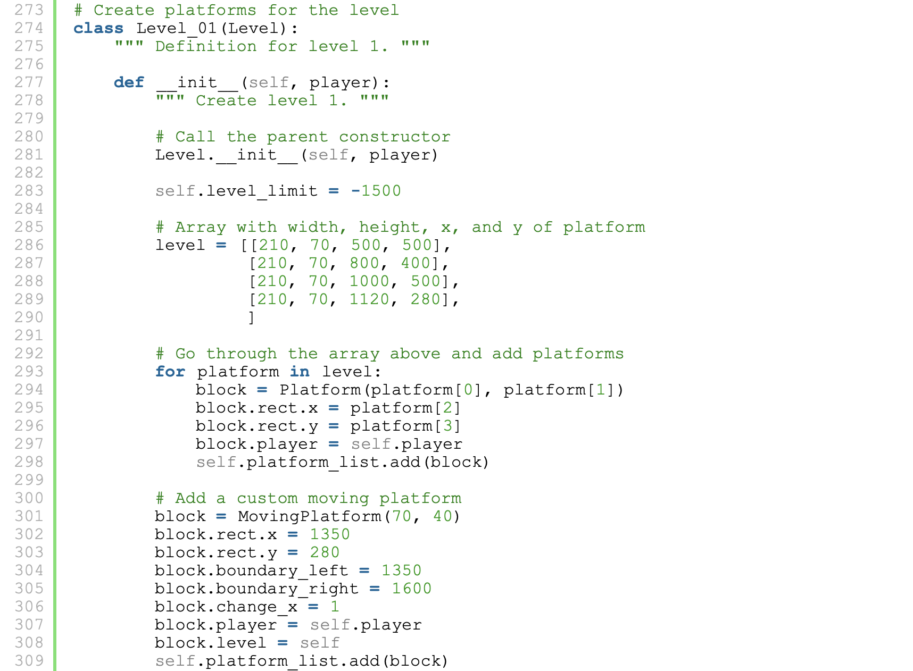
Mario-Like Game
Level
__init__
update
draw
shift_world
Level_01
__init__

Slide 27
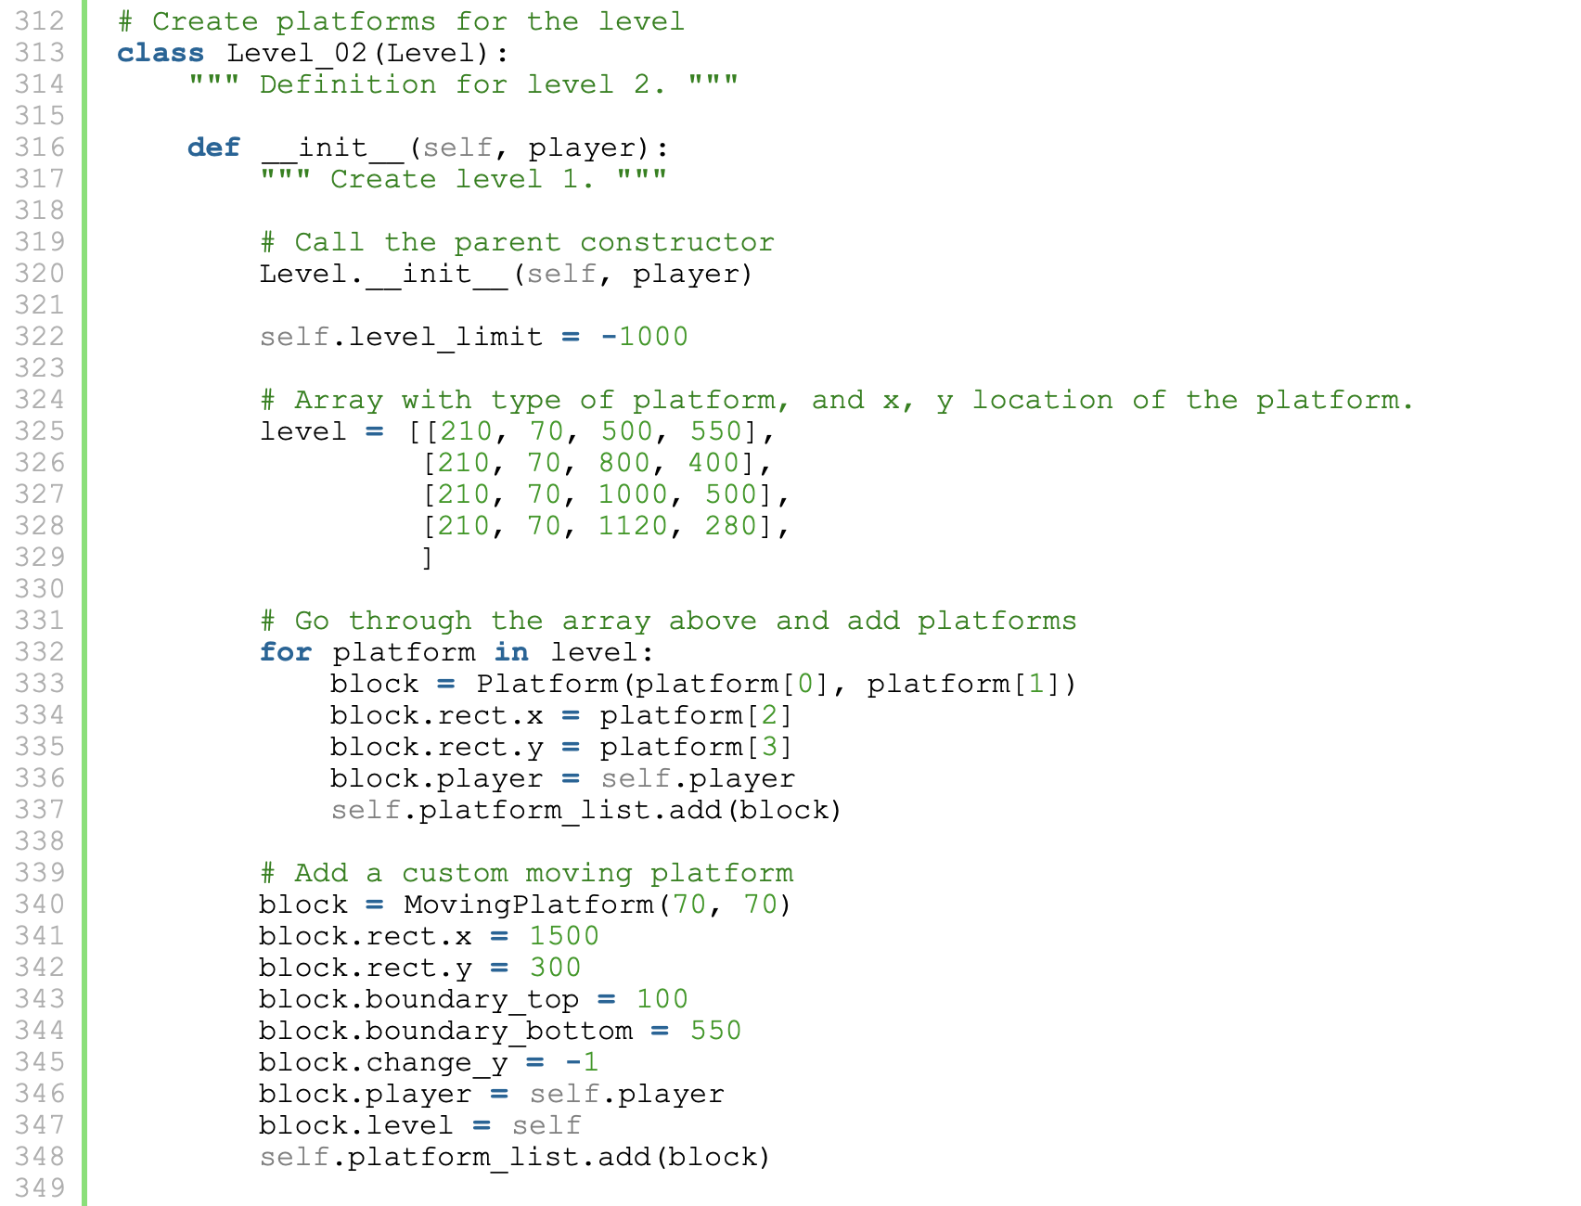
Mario-Like Game
Level
__init__
update
draw
shift_world
Level_02
__init__

Slide 28
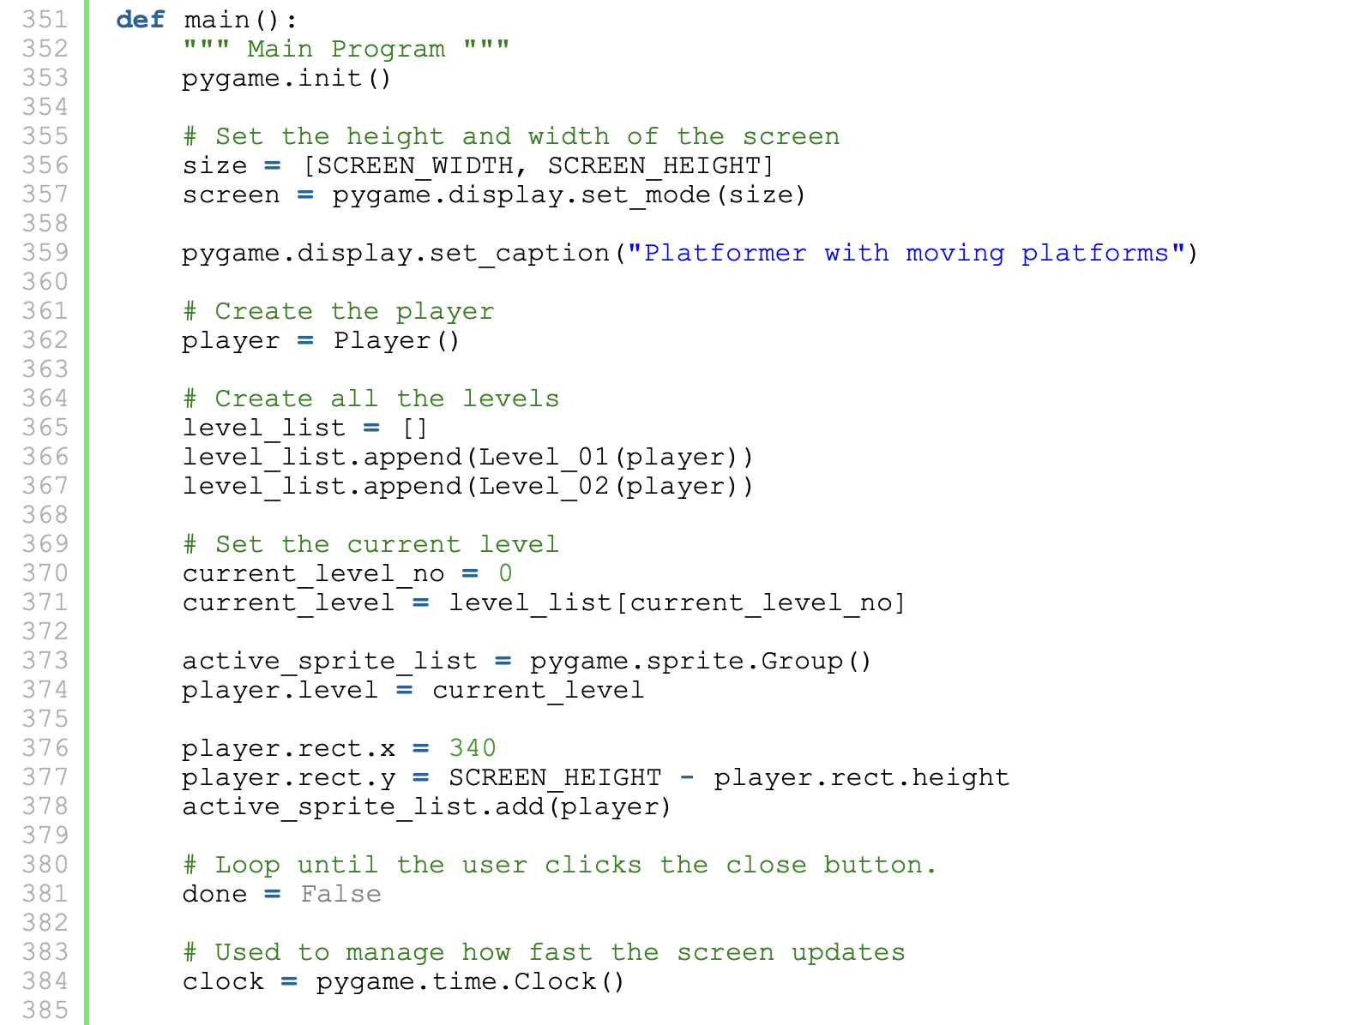
Mario-Like Game

Slide 29
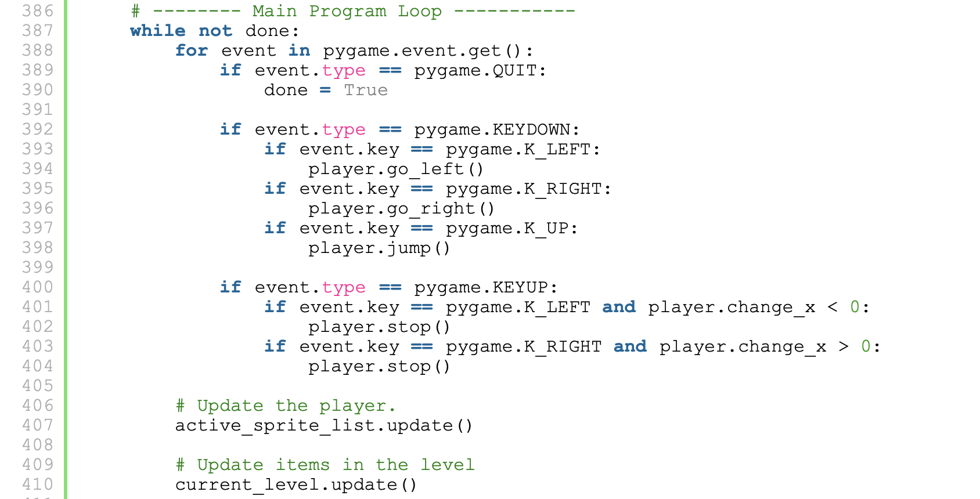
Mario-Like Game

Slide 30
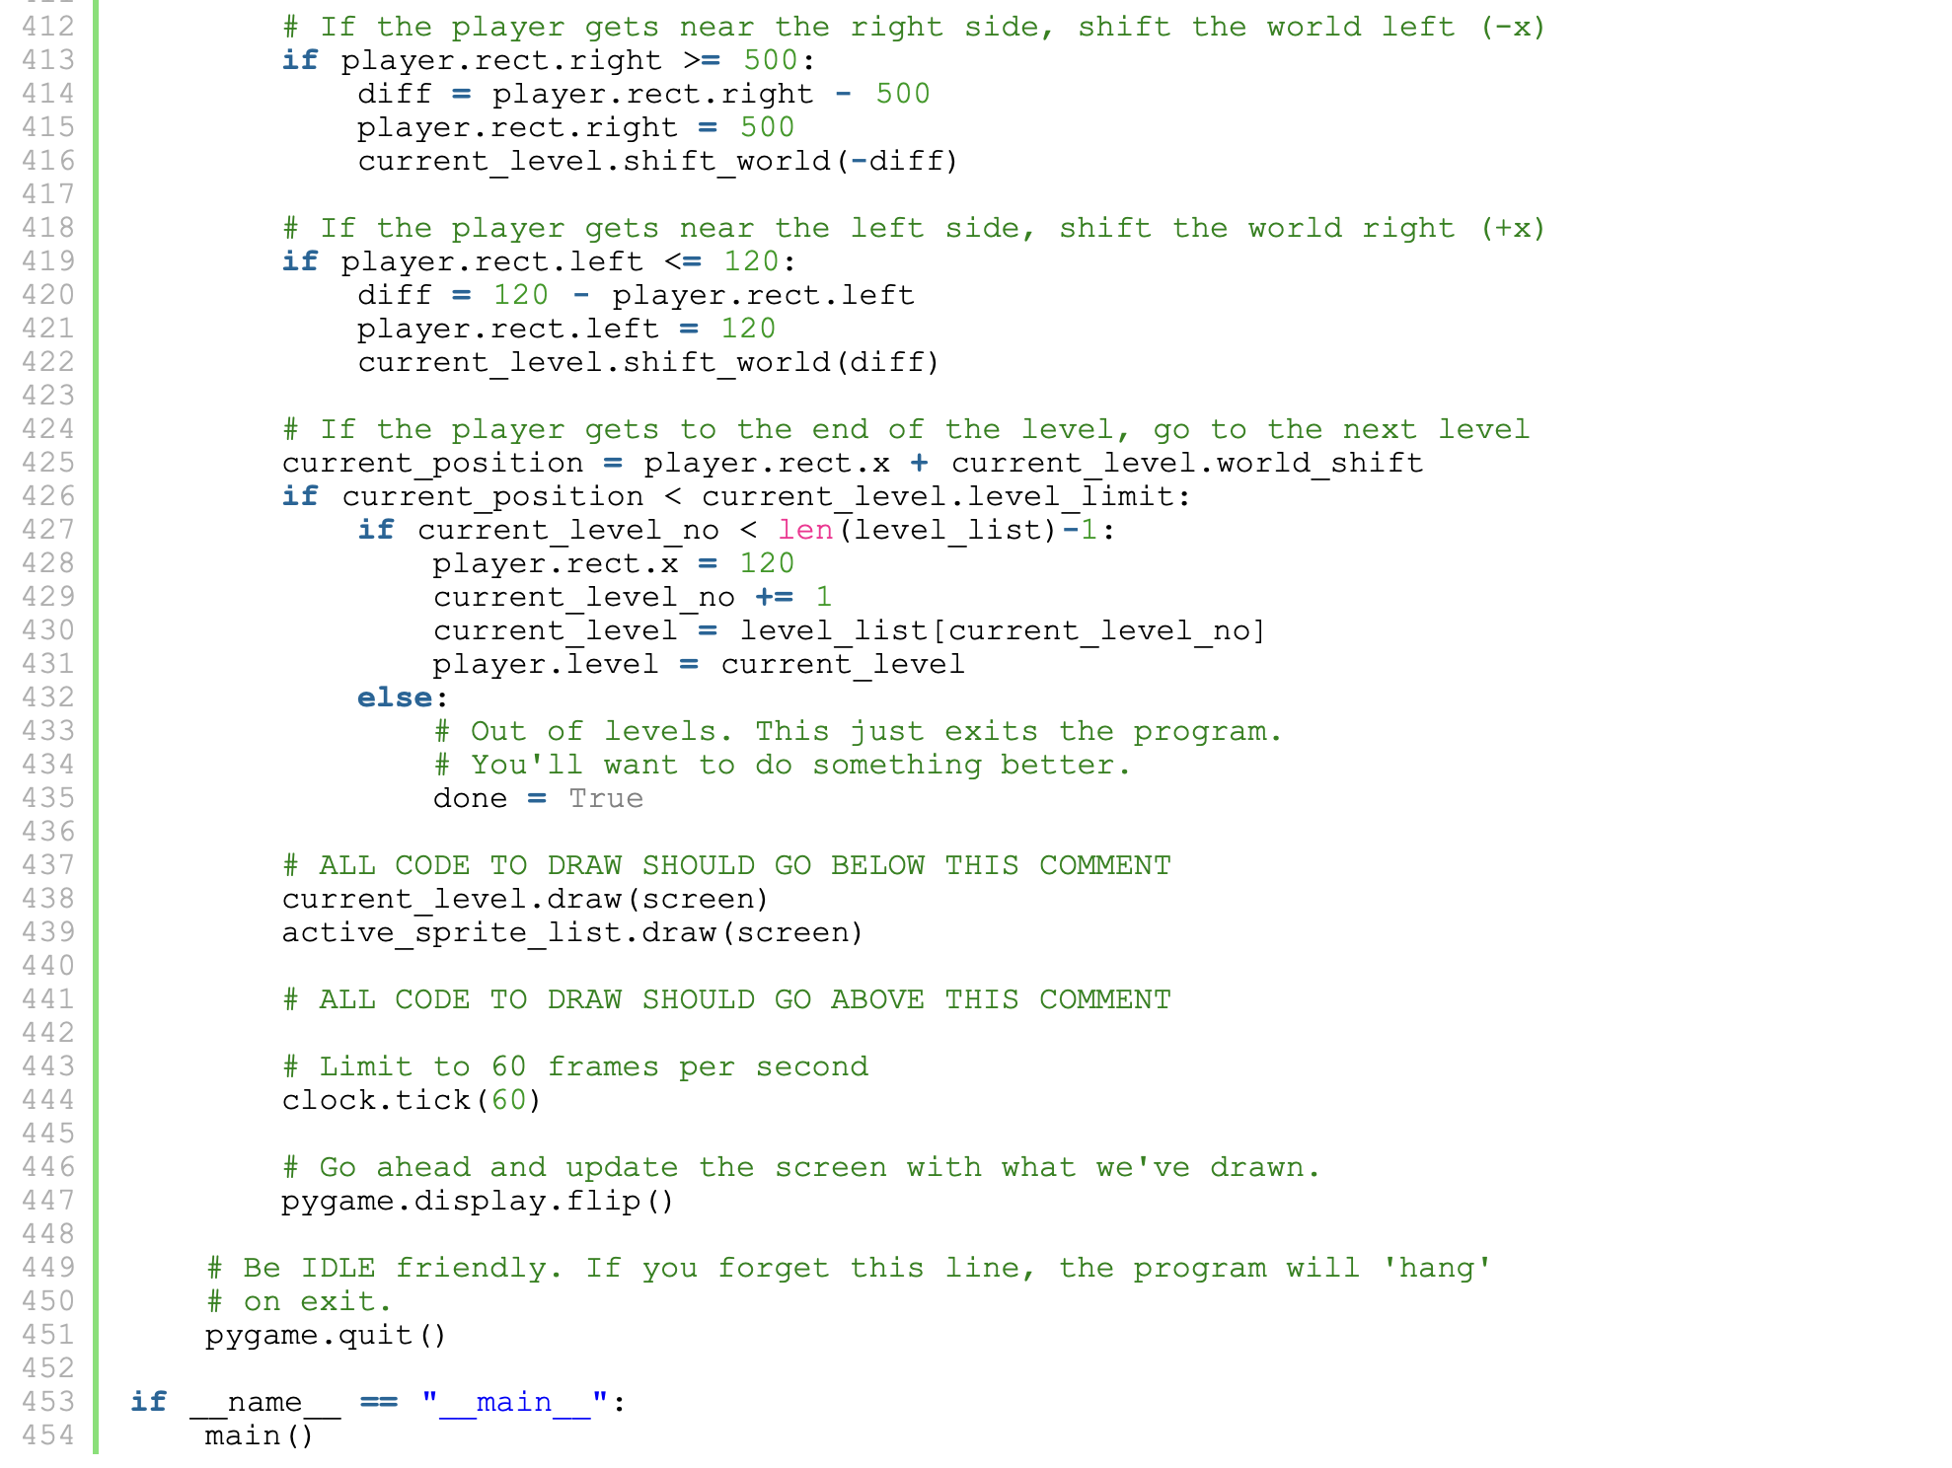
Mario-Like Game

Slide 31
References
http://programarcadegames.com/index.php?chapter=introduction_to_sprites&lang=en#section_13

